Slide 1
NLP
Final Project Review
Title: Enhancing Language Understanding in Replicated GPT-1 Architecture through Parameter Modification: A Comprehensive Investigation
Team Members
Anshul Shivhare
Atharva Dumbre
Gayatri Khairnar Mohammad Azharuddin

Slide 2
Final Code (GITHUB)
https://github.com/ansh07shiv/NLP_FInal_Project_GPT

Slide 3

Introduction
This research project aims to replicate the architecture of GPT-1 and subsequently explore the effects of deliberate parameter modifications on the model's language understanding capabilities.
The primary goal is to assess the impact of altered parameters on the model's performance, shedding light on potential enhancements or optimizations that can contribute to improved language comprehension.
Through systematic experimentation, we seek to identify key parameter adjustments that may lead to advancements in the underlying architecture, paving the way for more efficient and effective natural language processing models.

Slide 4

What is GPT?
Generative
GPT is inherently generative, meaning it has the ability to create coherent and contextually relevant text.
Pre-Trained
GPT undergoes a pre-training phase where it learns from a massive dataset without task-specific labels.
Transformer
GPT is built upon the Transformer architecture, a revolutionary model architecture in deep learning.
It is a type of artificial intelligence language model that uses a transformer architecture. The transformer architecture was introduced in a 2017 paper titled "Attention is All You Need" by researchers at Google.

Slide 5
GPT Architecture
The GPT-1 architecture is a twelve-layer decoder-only transformer, using twelve masked self-attention heads, with 64-dimensional states each (for a total of 768).
Rather than simple stochastic gradient descent, the Adam optimization algorithm was used; the learning rate was increased linearly from zero over the first 2,000 updates to a maximum of 2.5×10−4, and annealed to 0 using a cosine schedule.

Slide 6
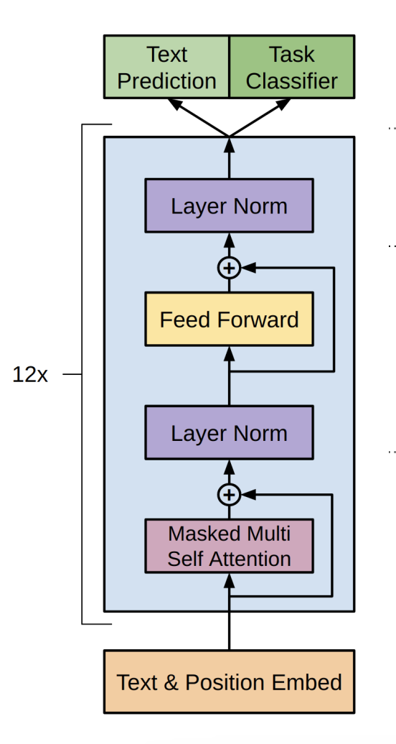
GPT Architecture

Slide 7
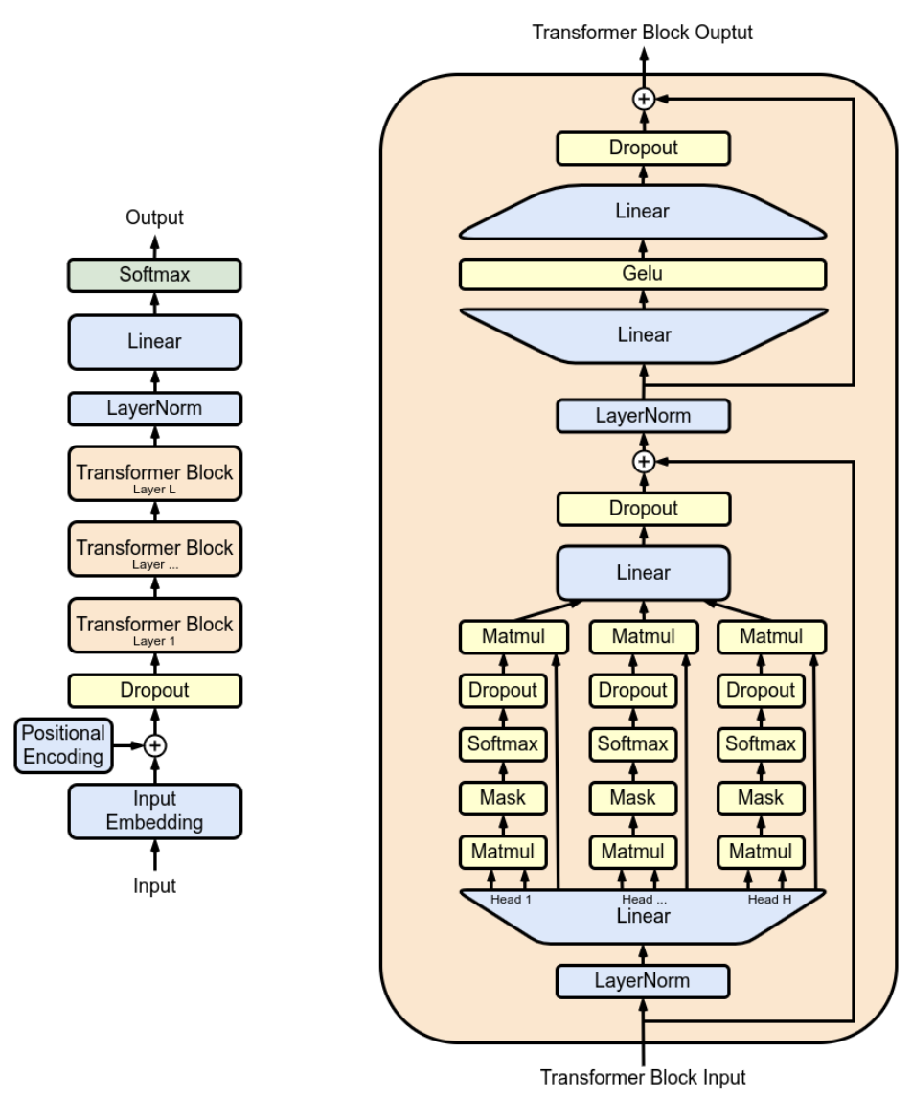
Replicating GPT

Slide 8
GPT Model Parameters
Batch Size
Block Size
Max Iterations
Learning Rate
Embedding Layer Size
Multi Head Attention Layer Size
Number of Transformer Layers
Dropout

Slide 9
Data Description
Open Web Text Corpus
Data Extraction from Reddit Submissions
Duplication Filtering
Random Shuffling and Parallel Download
Text Extraction using the newspaper Python Package
Newspaper package is used to extract content from websites. It can download the articles from the URL filtered out in previous steps
Language Filtering with FastText: Library by Facebook. Used to remove other language content
Tokenization and Length Filtering
Final Dataset Statistics:
After preprocessing, the dataset consisted of 38GB of text data.
There were 8,013,769 documents in the dataset.

Slide 10

GPT Model Parameters
Parameters Tuned
No of Transformer Layers
The number of transformer layers in a GPT (Generative Pre-trained Transformer) model can vary based on the specific version of GPT. Each transformer layer contains a multi-head self-attention mechanism and a feedforward neural network. The stacking of multiple transformer layers allows the model to learn hierarchical representations of input data.
GPT1: 12 Transformer Layer, GPT2: 12 to 24 Layers, and GPT3: 12 to 96 Layers
Learning Rate
Learning rate is a crucial hyperparameter that determines the size of the steps taken during the optimization process. It influences the convergence and stability of the training process. Common strategies include using a fixed learning rate or employing learning rate schedules.
Techniques: Linear Increment, Exponential Decay, Fixed Learning Rate.
Optimizer
The optimizer parameters refer to the hyperparameters associated with the optimization algorithm used during the training of a neural network, including GPT models.

Slide 11
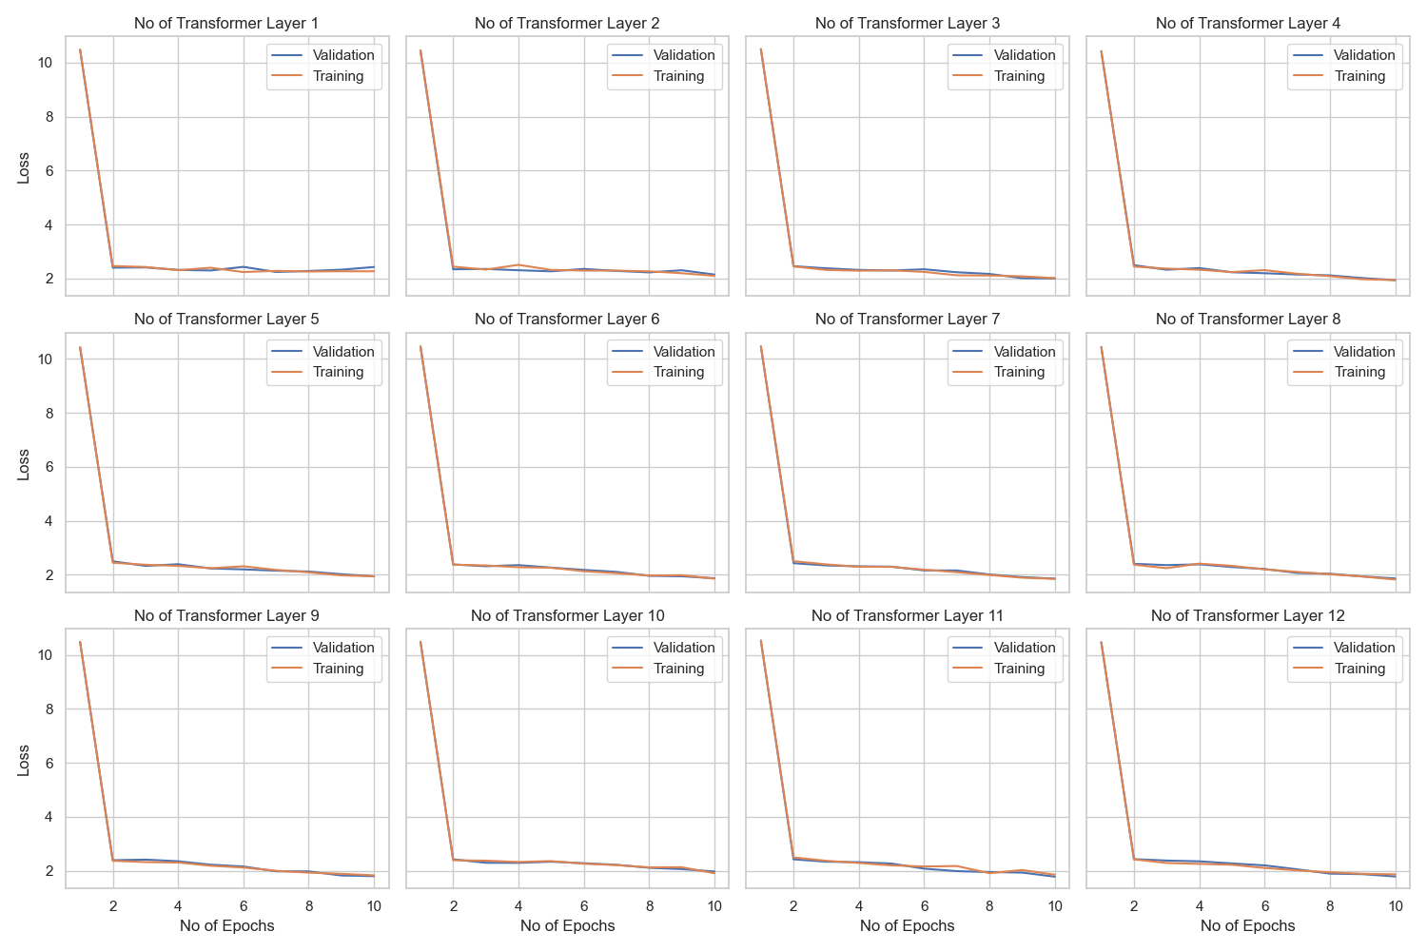
No of Transformer Layer Tuning Insights

Slide 12
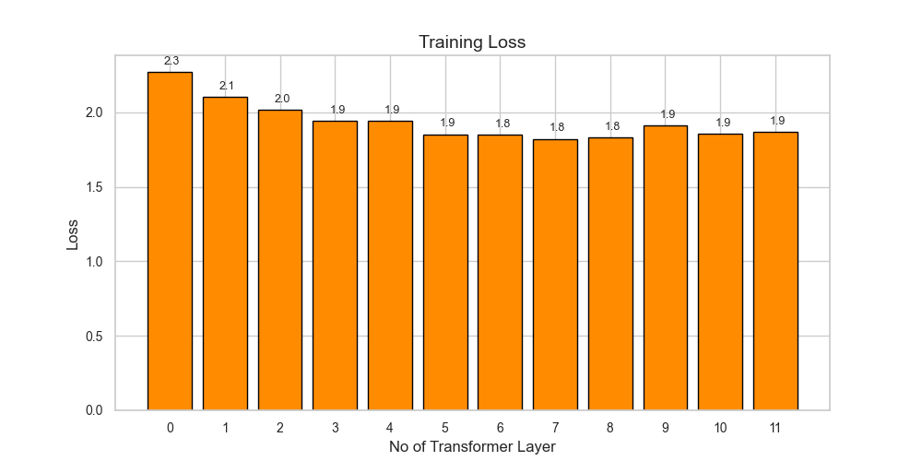
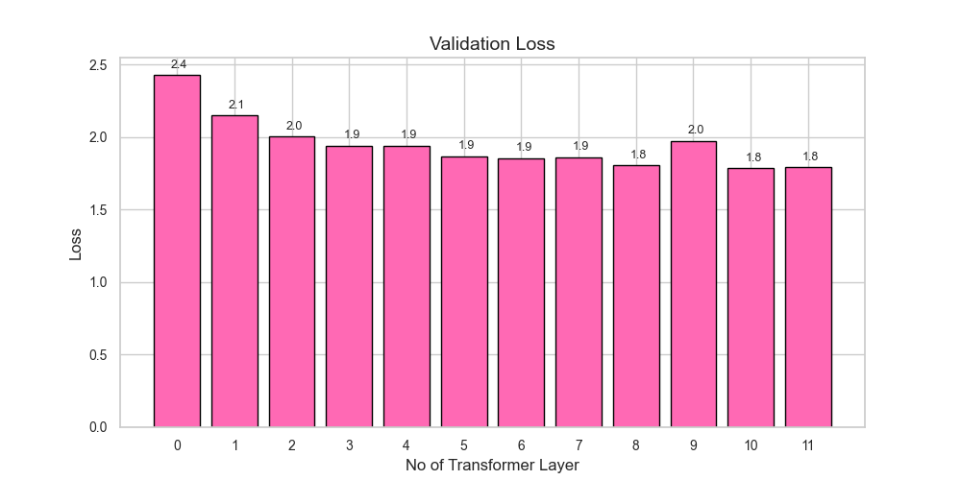
No of Transformer Layers

Slide 13
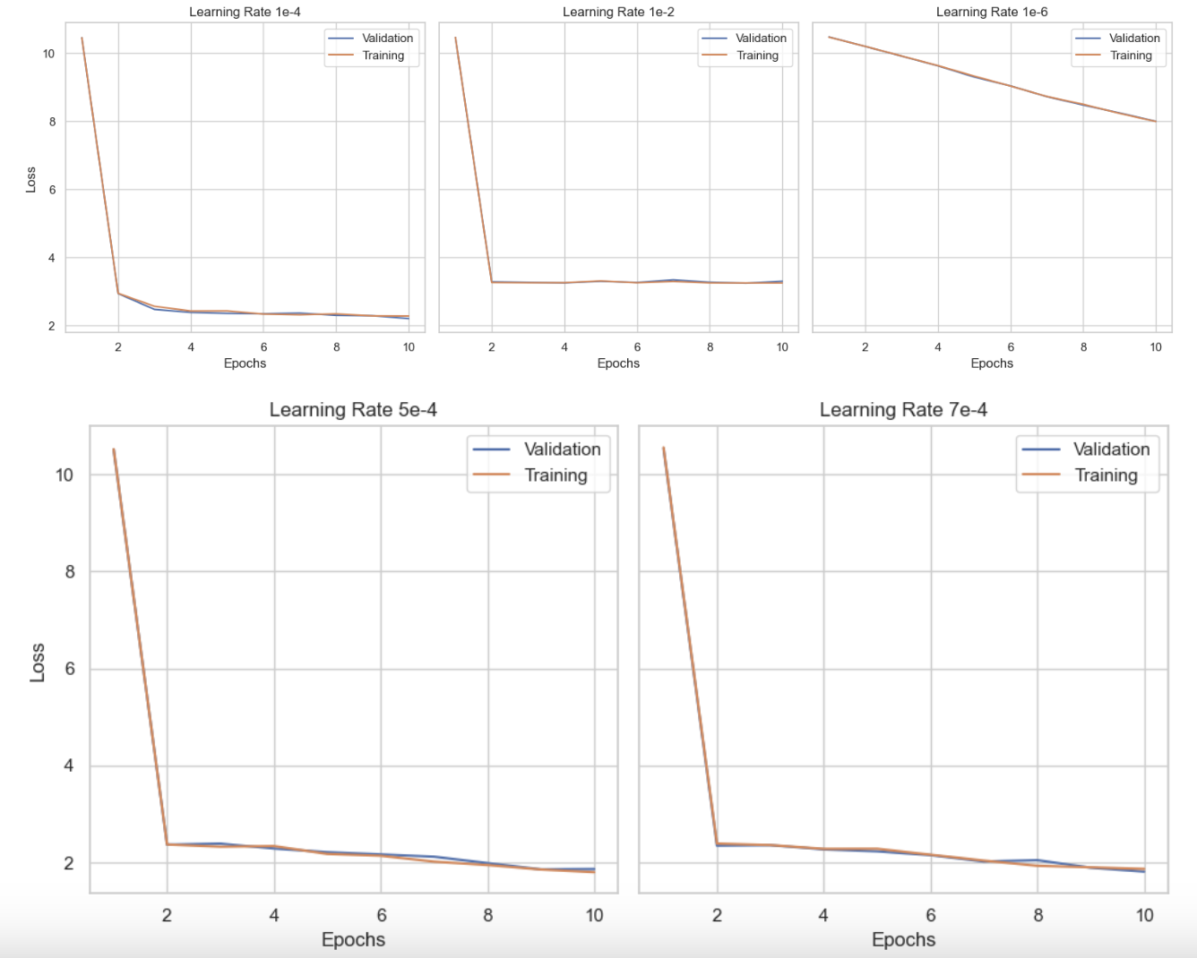
Learning Rate
Tuning Insights

Slide 14
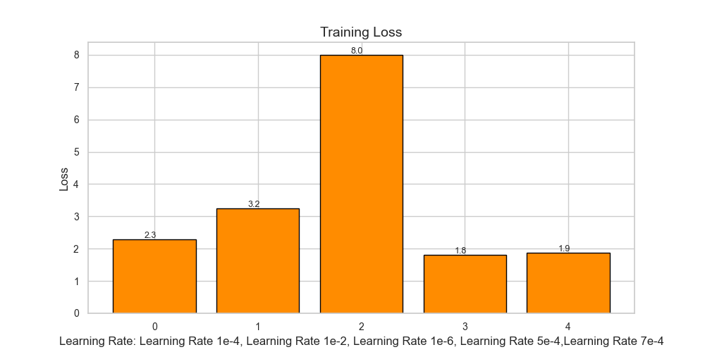
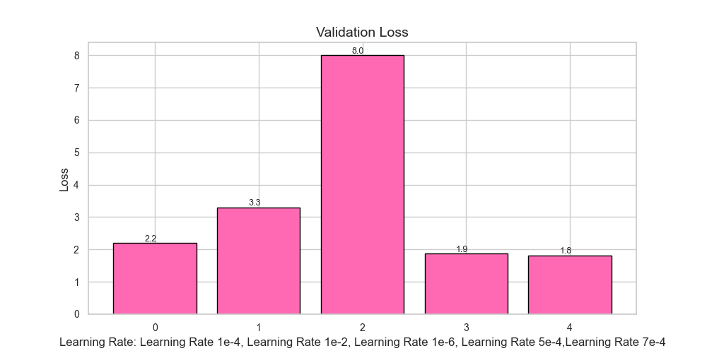
Learning Rate

Slide 15
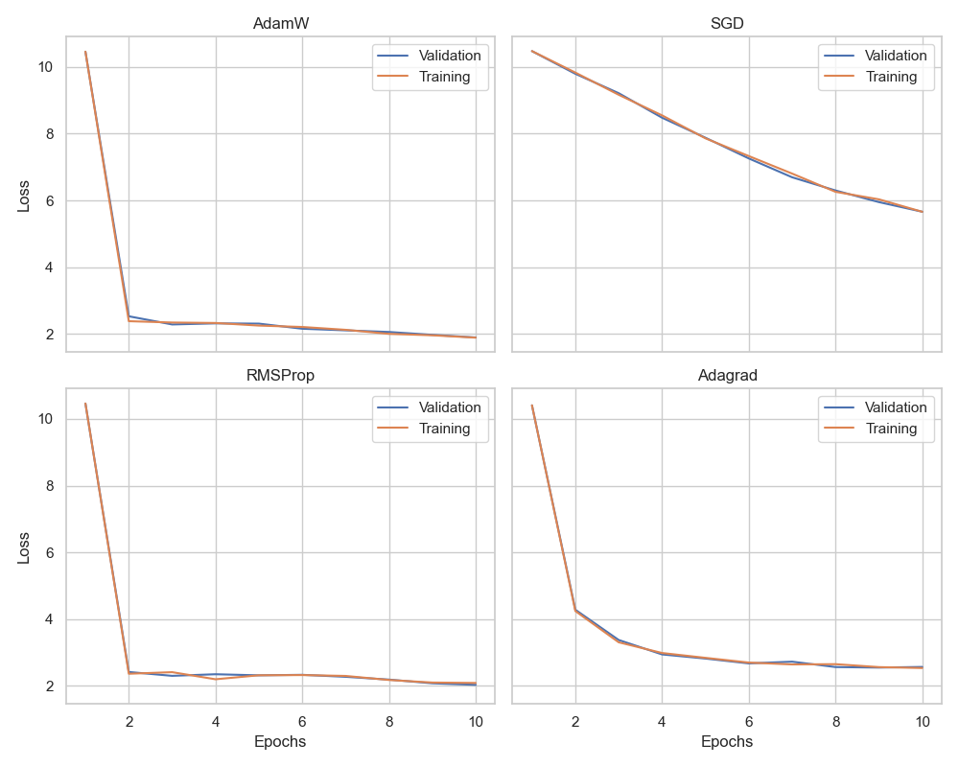
Optimizer
Tuning Insights
Adam: Adaptive Moment Estimation with Weight Decay: Adam combines the ideas of momentum and RMSprop to adaptively adjust learning rates for each parameter
SGD: SGD is the classic optimization algorithm where the model parameters are updated in the opposite direction of the gradient of the loss function
RMSProp: Root Mean Square Propagation : RMSProp adjusts the learning rates of each parameter adaptively based on the magnitudes of recent gradients
Adagrad: Adaptive Gradient Algorithm: dagrad adapts the learning rates for each parameter based on the historical sum of squared gradients.

Slide 16
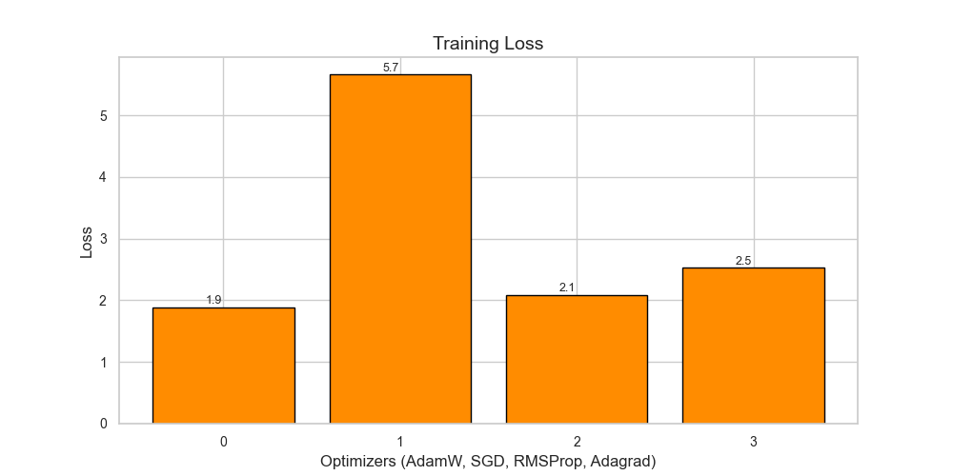
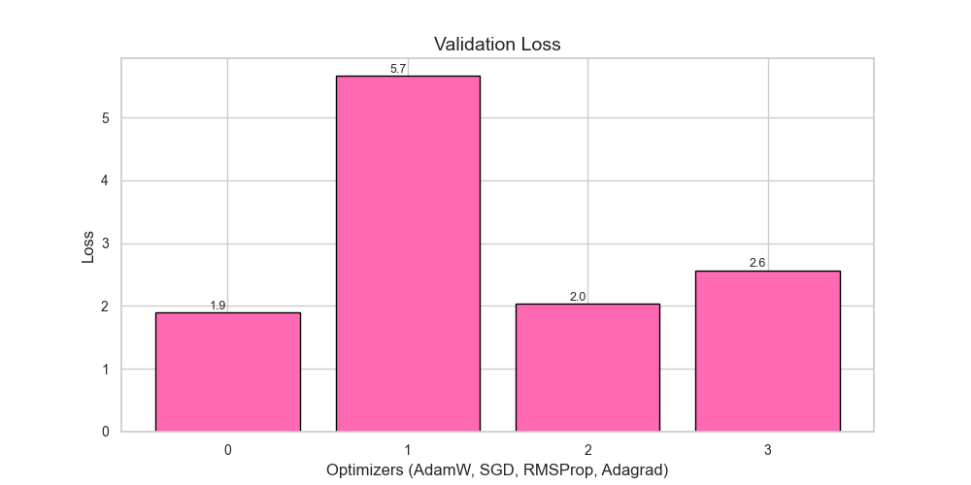
Optimizer

Slide 17
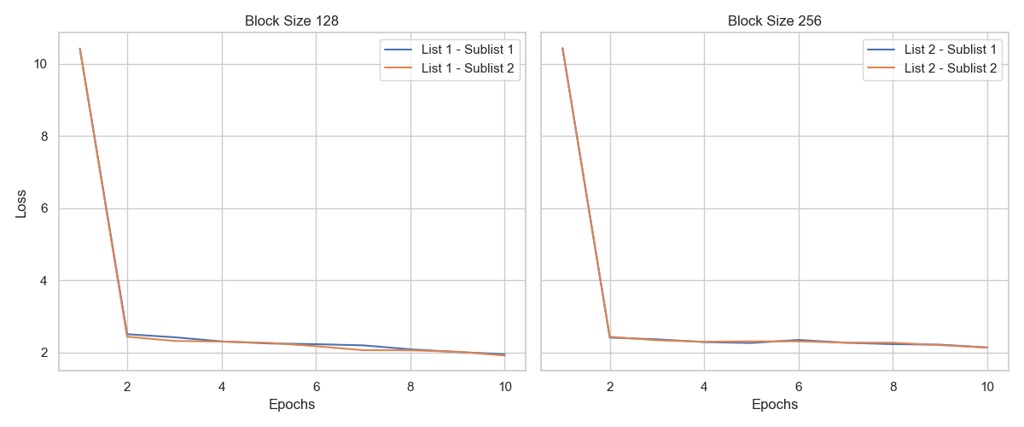
Block Size
Tuning Insights
Size of Data for Each Update while updating the Gradient during Optimization

Slide 18
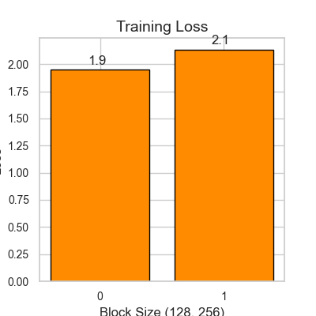
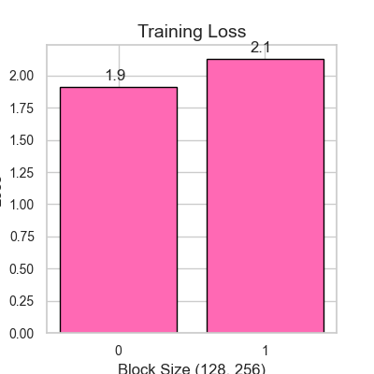
Block Size (128, 256)

Slide 19
Challenges and Limitations
Data Limitations
Quality Dependency: We've noticed that GPT models heavily lean on high-quality and diverse training data. Any biases or incompleteness in the data could result in outputs that are less accurate.
Domain Challenges:We found that GPT may face difficulties in specialized domains lacking diverse training data. To achieve optimal performance, fine-tuning becomes a necessary step.
Resources Limitations
Computational Demands: The journey of training and fine-tuning GPT models demands a significant amount of computational resources, which unfortunately can limit accessibility, especially for smaller entities.
Memory Intensity: Larger GPT models, such as GPT-3, exhibit a memory-intensive nature, which presents challenges when deployed on devices with limited memory.
Time Limitations
Training Time: We've experienced that training large transformer models is quite time-consuming.
Inference Challenges: Deploying GPT models for real-time inference poses computational challenges, especially in scenarios where low-latency is crucial, limiting their applicability.

Slide 20
Thank You

